Slide 1
Linux 102 Lab

Slide 2
Linux 102 Lab
This is the second introduction to the Linux Operating System
Materials needed
Linux Machine
Software Tools used
Linux Terminal

Slide 3
Linux 102 Lab
wc
Text viewing
File redirection (“pipes”)
grep
chown
chmod
find
su
sudo
du
df
tree

Slide 4
Prerequisites
You need to have a basic understanding of the following commands:
Navigating the file system (cd, cd .., ls, and pwd)
Creating/removing files (mkdir, rmdir, and rm)
Displaying/editing the contents of file (nano and cat)
Moving/copying files/directories (cp and mv)
You also need to know how to read manuals using the man command
A base understanding of using options/flags with commands
For example: ls -a

Slide 5

wc
Word count
Displays number of lines, words, bytes (characters)
Example: wc declaration.txt 33 1335 8117 declaration.txt
Example: wc artwar.txt 822 10874 61121 artwar.txt

Slide 6
Text viewing
head – prints first 10 lines
tail – prints last 10 lines
more – prints text one screen at a time
less – scrollable
sort – any guesses?

Slide 7
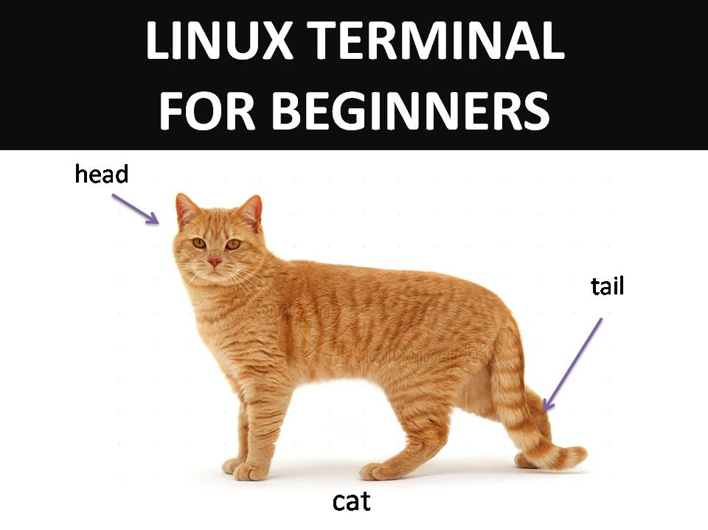

Slide 8
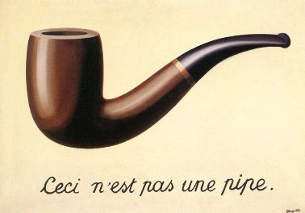
Redirection
One of the most powerful ideas in Linux/UNIX systems!
The pipe "|"
"Take the output of this and feed it to the input of that"
Examples:
ls | wc 19 19 243
cal | wc 8 39 188
ls -al | more
Notes:
Treachery of Images is a painting by René Magritte (1929). Translated, it says "This is not a pipe“.

Slide 9
Redirection
Standard Input = Keyboard
Standard Output = Monitor
< will use some other source for input
NOT Standard Input or STDIN
> will redirect some other destination for output
NOT Standard Output or STDOUT
Replaces destination with output
>> will append output to destination
Attaches output to the end of an existing file

Slide 10
Redirection
Examples:
cat /proc/cpuinfo > cpuinfo.txt
wc /proc/cpuinfo >> cpuinfo.txt
wc catb.txt >> document_info.txt wc beginning.txt >> document_info.txt

Slide 11
grep
Search tool
Examples:
Find “Daisy” in Gatsby cat gatsby.txt | grep "Daisy"
Only number of lines that match: cat gatsby.txt | grep –c "Daisy"
Show only lines that don’t match cat gatsby.txt | grep -v "Daisy"

Slide 12
grep
Find string of text in files: grep "worst of times" *.txt grep "worst of times" ~/Documents
Case insensitive grep -i "he has" *.txt

Slide 13
grep
List only the filenames containing the text: grep -l "he has" *.txt
Show the line number of the match:
grep -n "dawn" anthem.txt
Show lines around match:
After: grep –A 1 "he has" declaration.txt
Before: grep –B 1 "he has" declaration.txt
Combined: grep –C 2 "he has" declaration.txt

Slide 14
File Ownership
ls -al
Shows all files in a directory and attributes (long)
Ownership and Permissions are among those details
chown to change ownership
chmod to change mode or permissions
Two methods for chmod
Set mode for owner, group, or others

Slide 15
chown
Change Owner
chown user1 someFile
Change Group
chown :band someFile

Slide 16

chmod - Letters
Text-based permission assignments
r = read = user can view contents of the file
w = write = user can edit/save changes to the file
x = execute = user can execute the file (or access dir)
Set or revoke using + and -
ugoa
Whose permissions are changing?
The user (owner)
The group
The others
All Users

Slide 17
chmod - Letters
Set file to execute for everyone: chmod +x someScript.py
Only the file's owner gets execute chmod u+x someScript.py
Remoke write access to the group chmod g-w studyGuide.txt
Revoke read access to group and others chmod go-r myDiary.txt

Slide 18
chmod - Numeric
Numeric permissions assignments
4= read
2 = write
1= execute
What permissions do you want to grant? Add 'em up!
777 - read, write, execute for everyone!
664 - owner and group can read and write, others can just read
755 - owner can do it all, everyone else can only read and execute

Slide 19
find/grep
Let’s read the manual for the find command man find
Let’s create text files and folders on the desktop cd Desktop; mkdir Folder1 Folder2; touch File1 File2
Navigate to the root and use the find command to search for one of the text files cd /; find -name File1
Use the superuser command to search all the directories sudo find -name File1

Slide 20

Superuser
On Linux, the administrator account is root
root is also referred to as the “super user” because the root account has powers and privileges other user accounts do not
You can request the “superuser” to do something for you by using the sudo command
Examples: sudo whoami sudo cat /etc/shadow

Slide 21
du/df
du – show Disk Usage
du ~
Make it “human readable”: du -h /home/student
df – show how much of the disk is free
df
Make it “human readable”: df -h

Slide 22
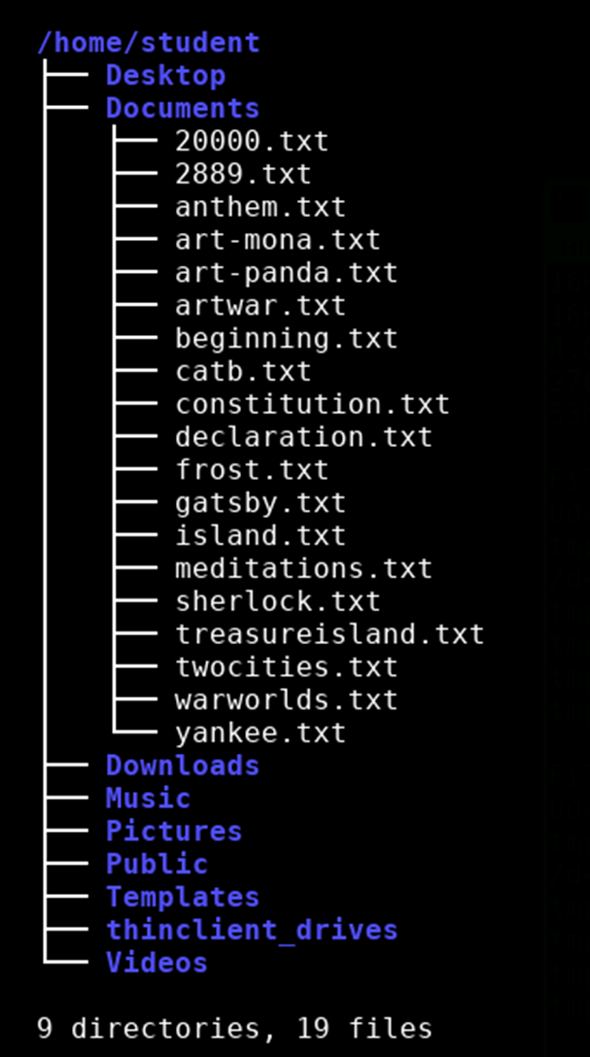
tree
Text-based graphical layout of file structure
tree
Not installed by default on some distributions of Linux
To install: sudo apt-get install tree

